Slide 1

Tower Defence
COMP 397 - Web Game Programming
Yun Kui Pan
GitHub: https://github.com/y-pan/TowerDefence
Website: http://studentweb.cencol.ca/ypan46/TowerDefence/

Slide 2
Development Tool/lib
Visual Studio 2013
Paint.net
TypeScript, Createjs ...

Slide 3
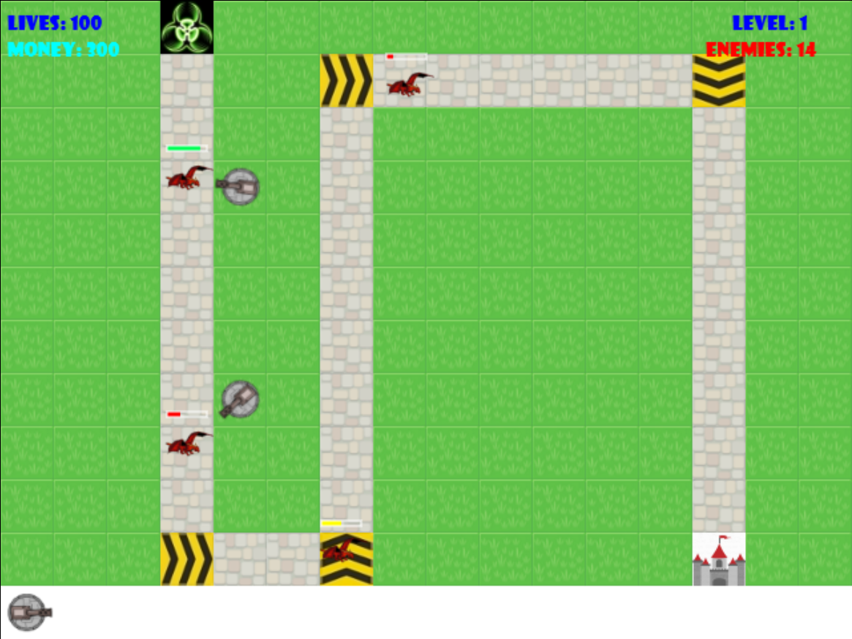
Level 1

Slide 4
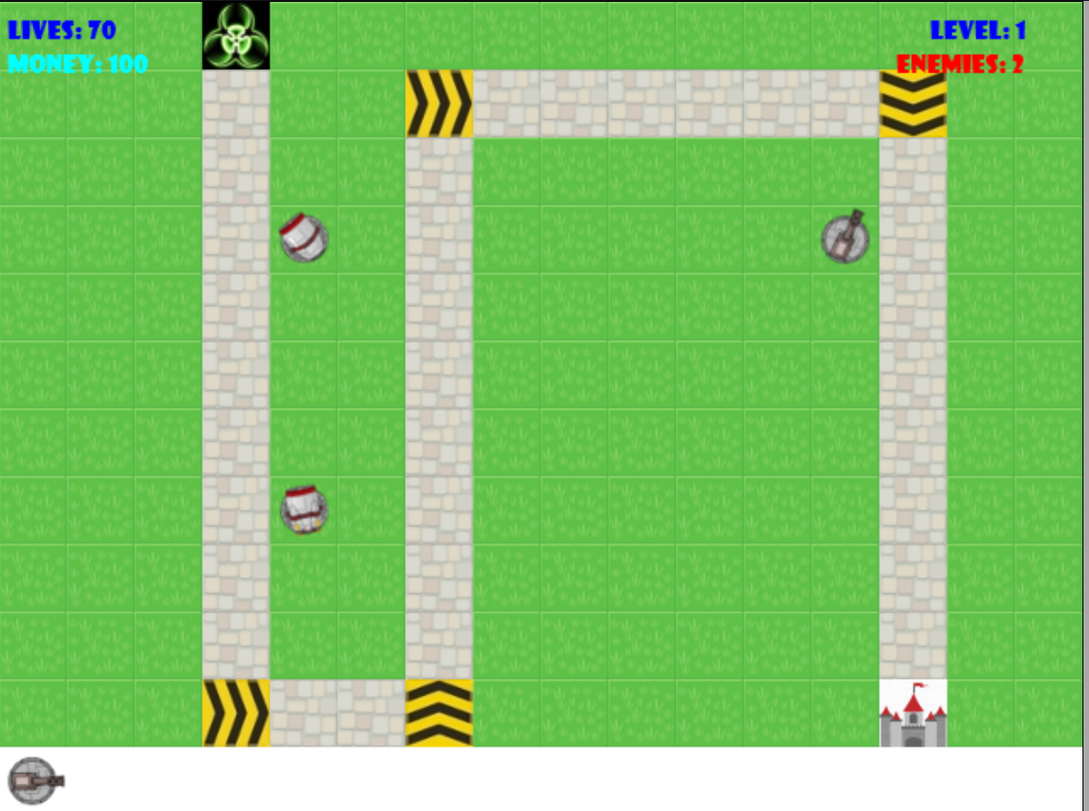

Slide 5
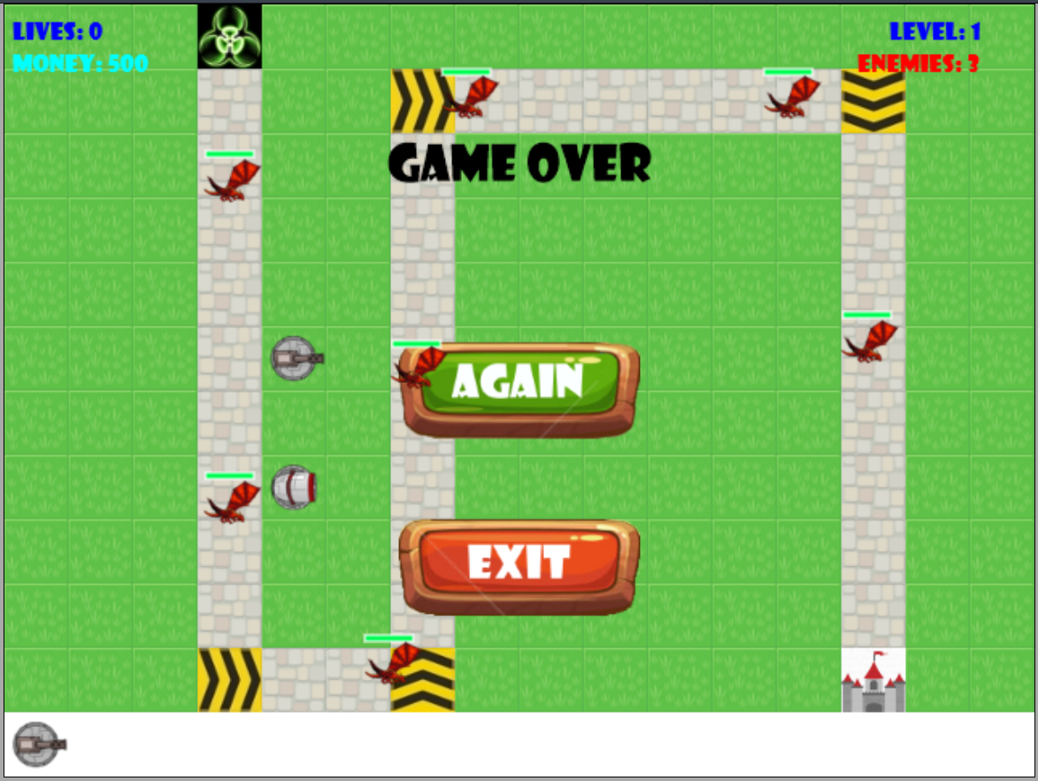

Slide 6
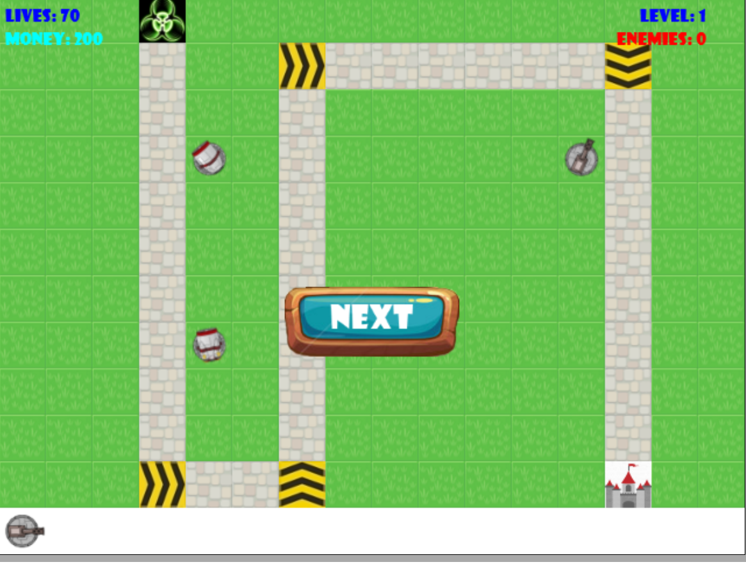

Slide 7
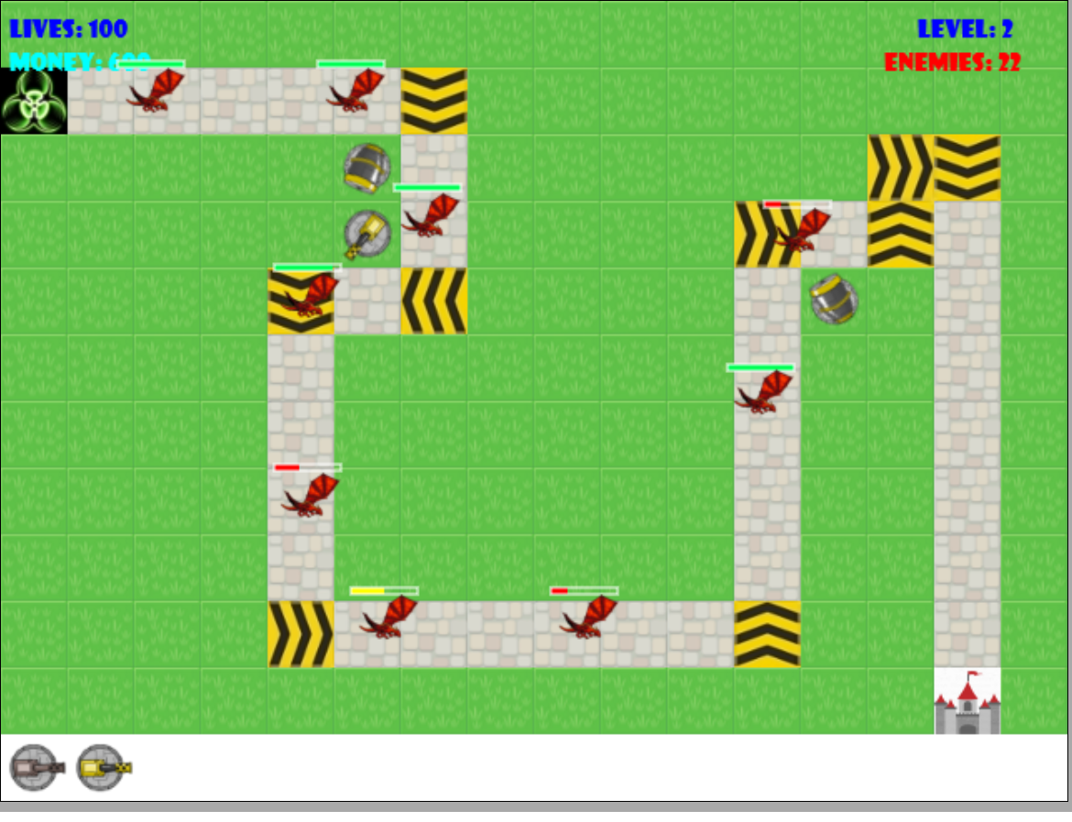
Level 2

Slide 8
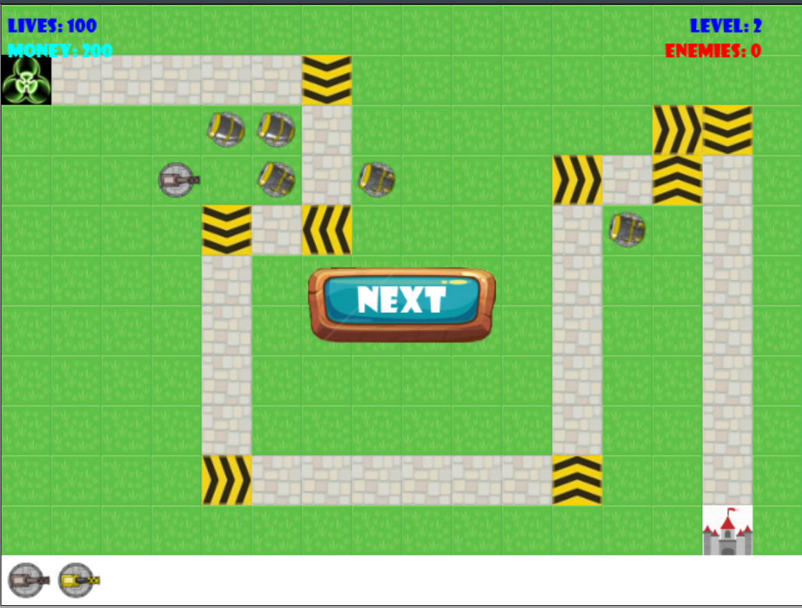

Slide 9
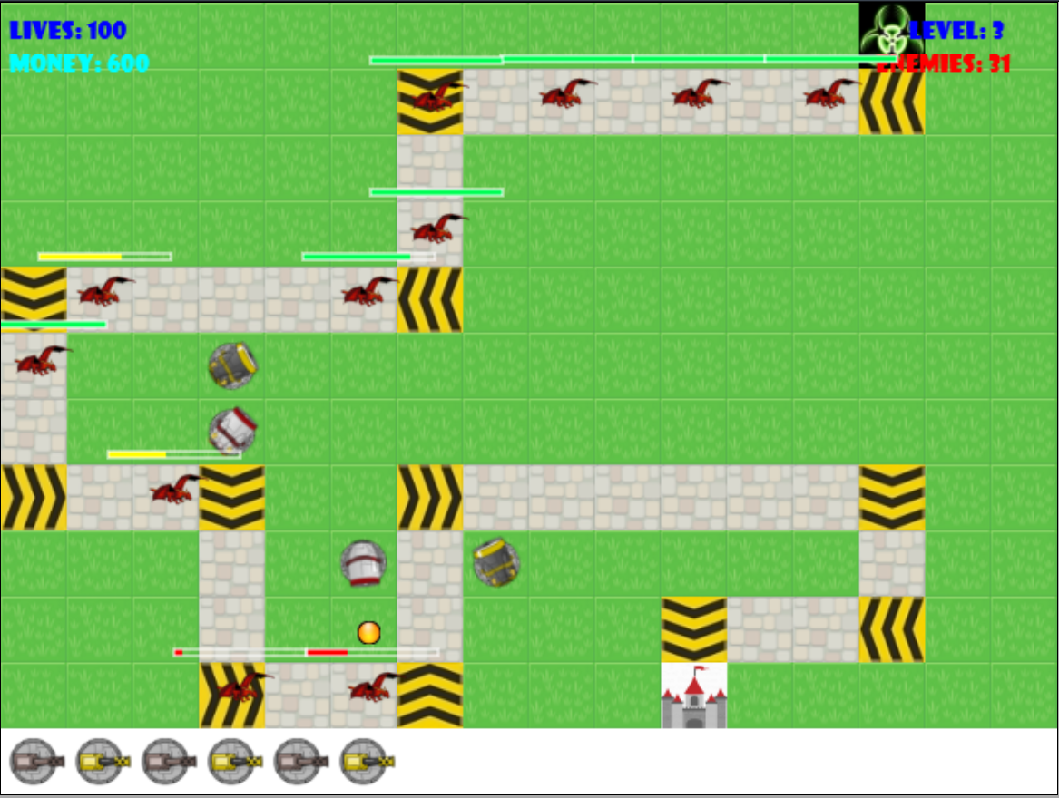
Level 3

Slide 10
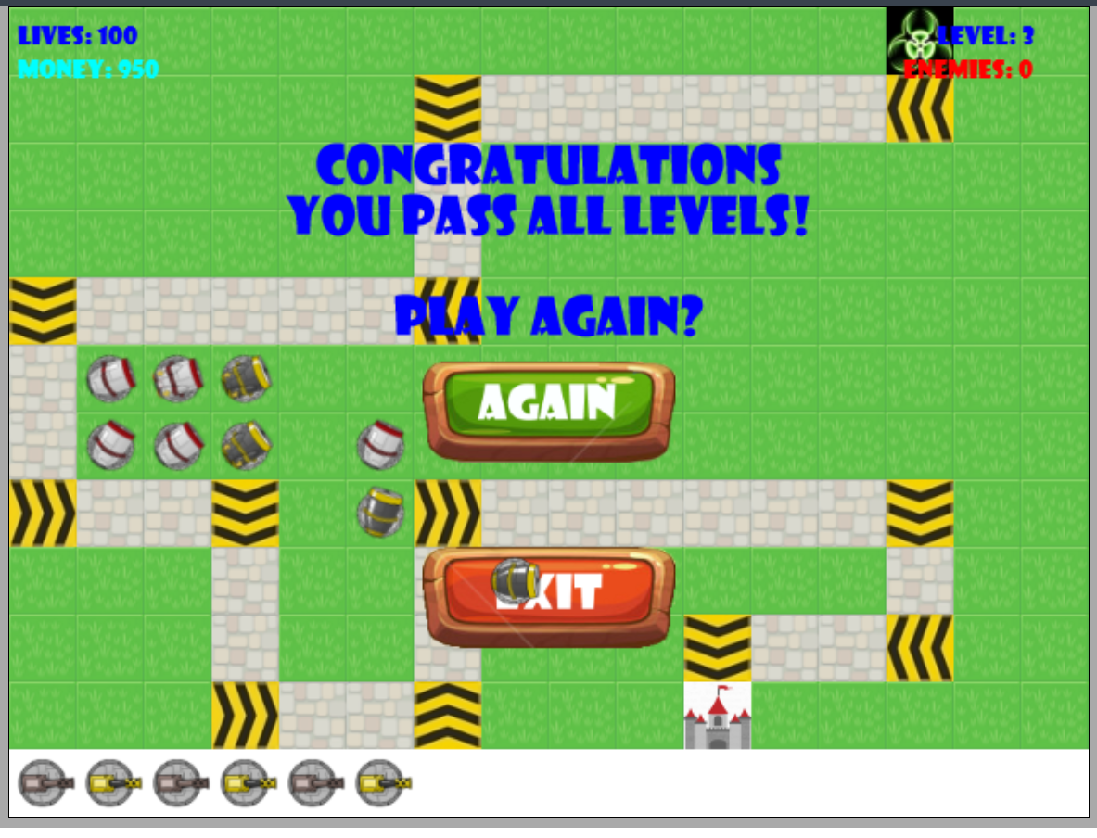

Slide 11




















Assets

Slide 12
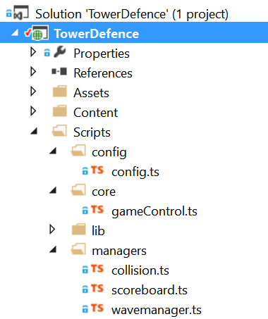
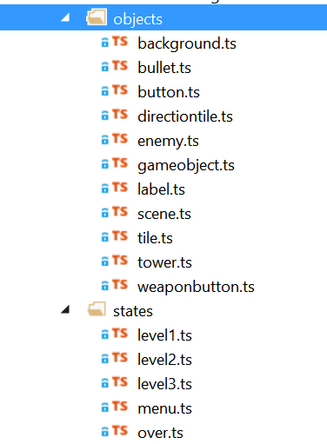
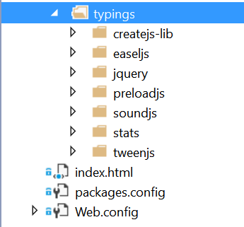
Game Structure

Slide 13
Lessons learned
Visual Studio and TypeScript make web programming much easier
Always backup the file and commit to github
Always comment on the codes
Programming continually, to save time on recalling the codes
Better to manage constant values in one place

Slide 14
Thanks
Play >>

